Slide 1

Dr. Babasaheb Ambedkar Marathwada University,
Chhatrapati Sambhajinagar-431001
Utilizing hyperspectral non-imagine data
to identify materials used in ancient structures
Guided By:
Dr. Sachin. N. Deshmukh
Professor
Presented By:
Mr. Dhananjay kamble
M.Sc. AI 2nd year

Slide 2
Contain
Introduction
Problem Statement
Objective
Types of Ancient structure buildings
Application Areas
The most common materials include
Tools/Devices
Methodology
Feature extraction
Result
Conclusion

Slide 3
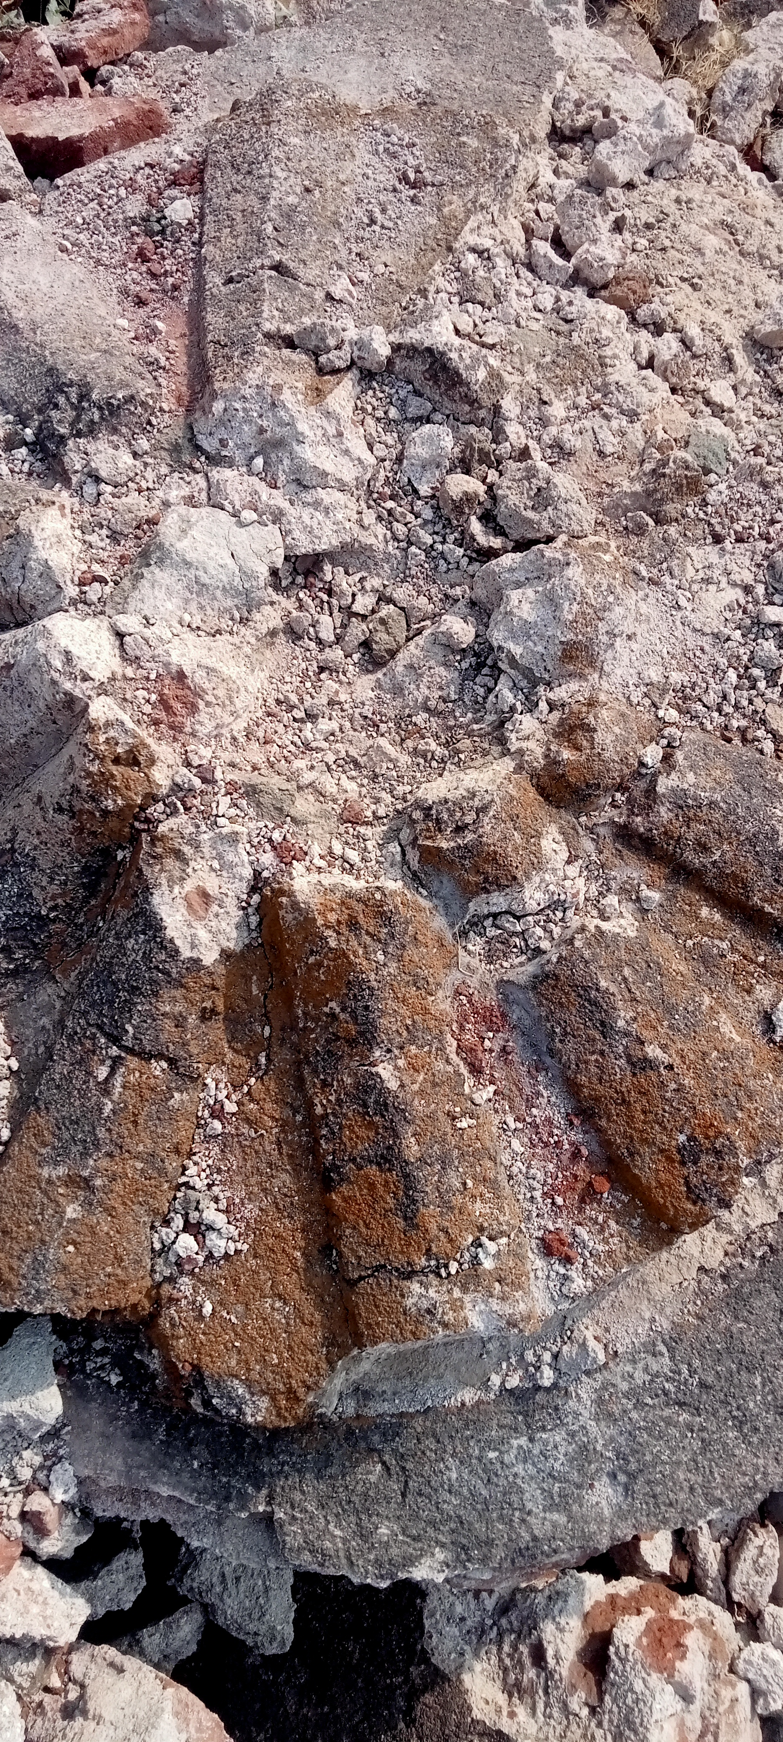
Introduction
In our Chh. Sambhajinagar, there are many ancient structure presents but we focus on ancient structure in university.
This research is very beneficial for rebuilding of ancient structure.
To finding which contain they used in ancient construction by their spectral signature or range of wavelength.
Fig 1. Ancient Structure

Slide 4
Conti…
Hyperspectral Non-Imaging refers to the analysis of spectral data without capturing spatial information. Unlike hyperspectral imaging, which provides both spatial and spectral details, non-imaging hyperspectral analysis focuses only on the spectral signatures of materials.
Measures light reflectance or absorption across multiple wavelengths.
Used for material identification, chemical analysis, and environmental monitoring.
Applied in fields like agriculture, and ancient material analysis (e.g., our project on historical structures).

Slide 5
Problem Statement
Traditional methods for identifying materials in ancient structures are invasive, time-consuming, and may cause.
Hyperspectral non-imagining data offers a non-destructive alternative but presents challenges in data processing, interpretation, and distinguishing between similar materials.
There is a lack of comprehensive spectral libraries specifically tailored for ancient construction materials.
Advanced analytical models and machine learning techniques are needed to effectively classify and identify materials from hyperspectral non-imaging data.

Slide 6
Objectives
To study the spectral data of materials used in ancient structure.
To develop a comprehensive spectral library.
To analyze the spectral data.
To develop the machine learning model for accurately classify materials.

Slide 7
Types of Ancient Structure Buildings
Ancient structures were built using various materials and techniques based on the civilization, geography, and purpose. These structures can be classified into different types.
Megalithic Structures (Prehistoric & Early Civilizations)
Religious & Temple Structures.
Palaces & Forts .
Civic & Public Buildings
Residential Structures
Defensive Structures

Slide 8
Application areas
Geology/mining
Defence
Environmental
Agriculture
Material

Slide 9
The most common materials include
1. Stone
Limestone – Used in structures like the Egyptian Pyramids and Bibi Ka Maqbara.
Sandstone – Used in Indian temples and forts.
Granite – Used in South Indian temples (e.g., Brihadeeswara Temple).
Marble – Used in the Taj Mahal and Mughal architecture.
2. Bricks & Clay
Sun-dried (mud) bricks – Used in Mesopotamian structures.
Fired bricks – Used in Indus Valley Civilization (Mohenjo-Daro, Harappa).
Terracotta – Used in Chinese and Indian architecture.
3. Mortar & Binding Agents
Lime Mortar – A mix of lime, water, and sand, used in many historical buildings.
Mud Mortar – Used in ancient Indian and Mesopotamian structures.
Gypsum Plaster – Used in Egyptian pyramids.
4. Natural Additives
Bel fruit (Wood apple pulp) – Used in Bibi Ka Maqbara construction.
Jaggery (Unrefined sugar) – Added to mortar for strength.
Ambada Vegetable (Roselle plant extract) – Used as a binding agent.
Udid Dal (Black gram paste) – Added for durability in Indian structures.

Slide 10
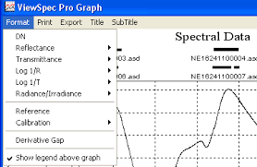
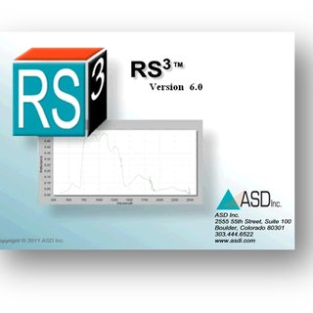
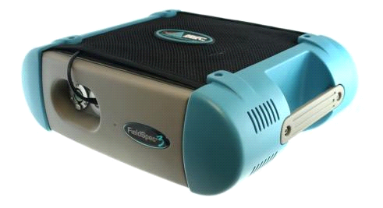
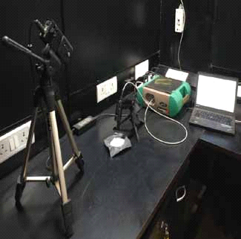
Tools/devices
Fig 3. Viewspec pro software
Fig 2. Setup of spectroradiometer
Fig 4. ASD field spec 4
Fig 5. Rs3 software

Slide 11
Methodology

Slide 12
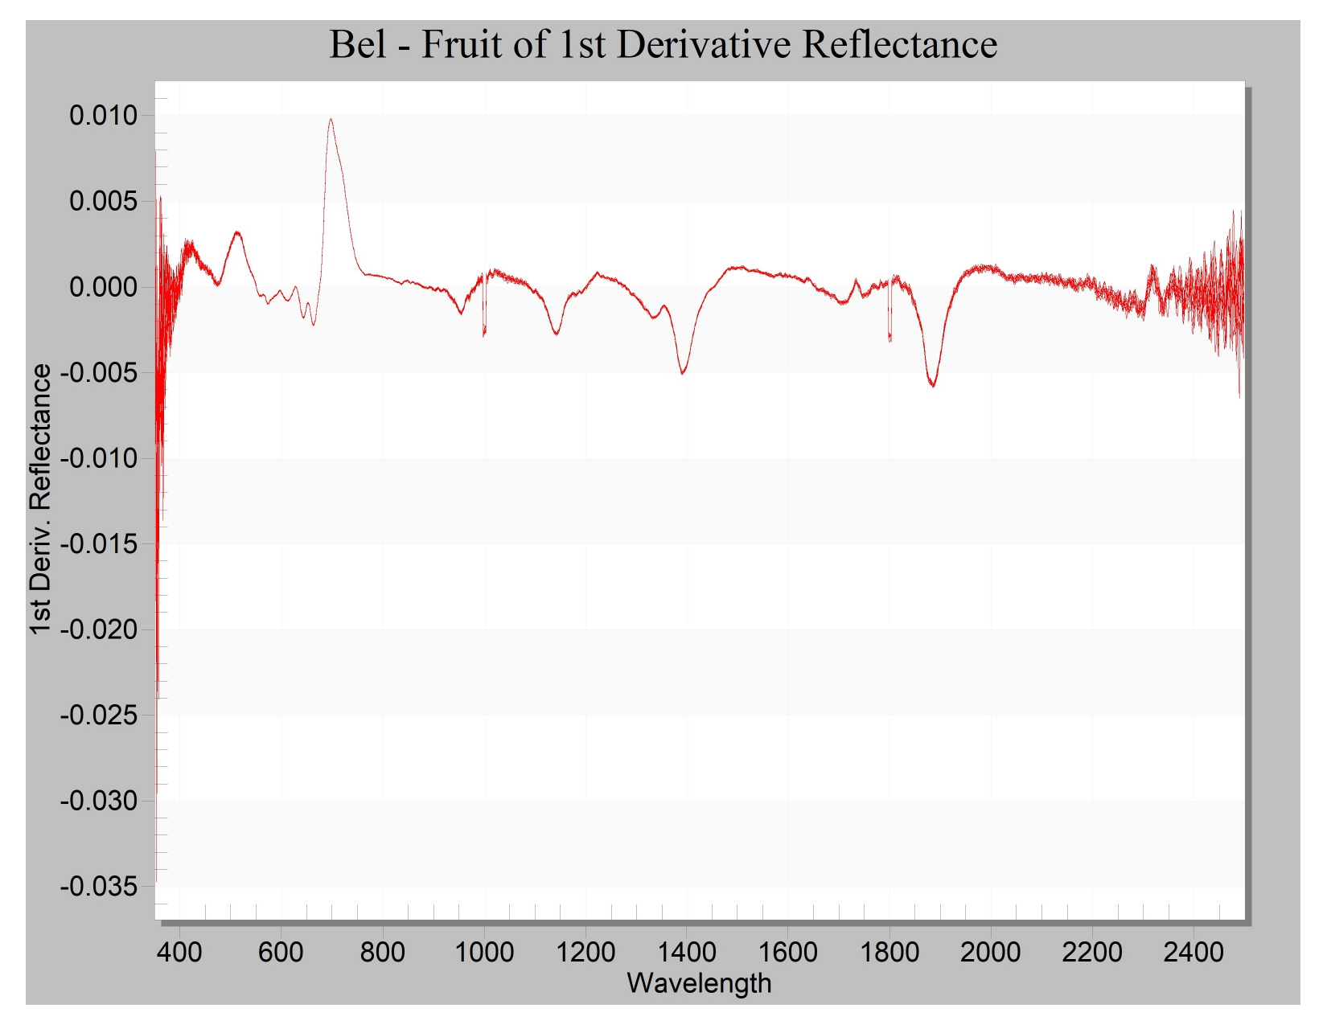
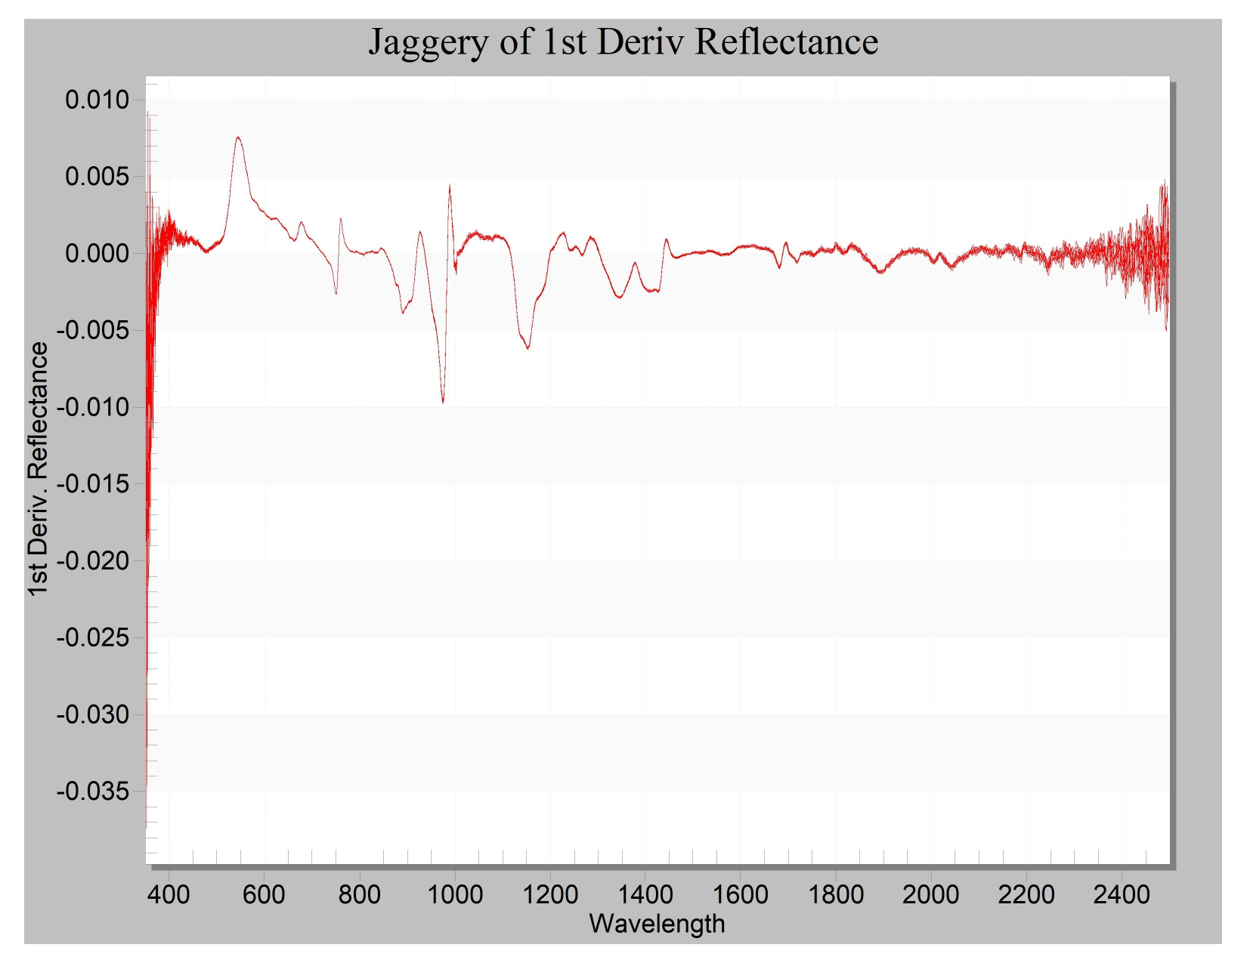
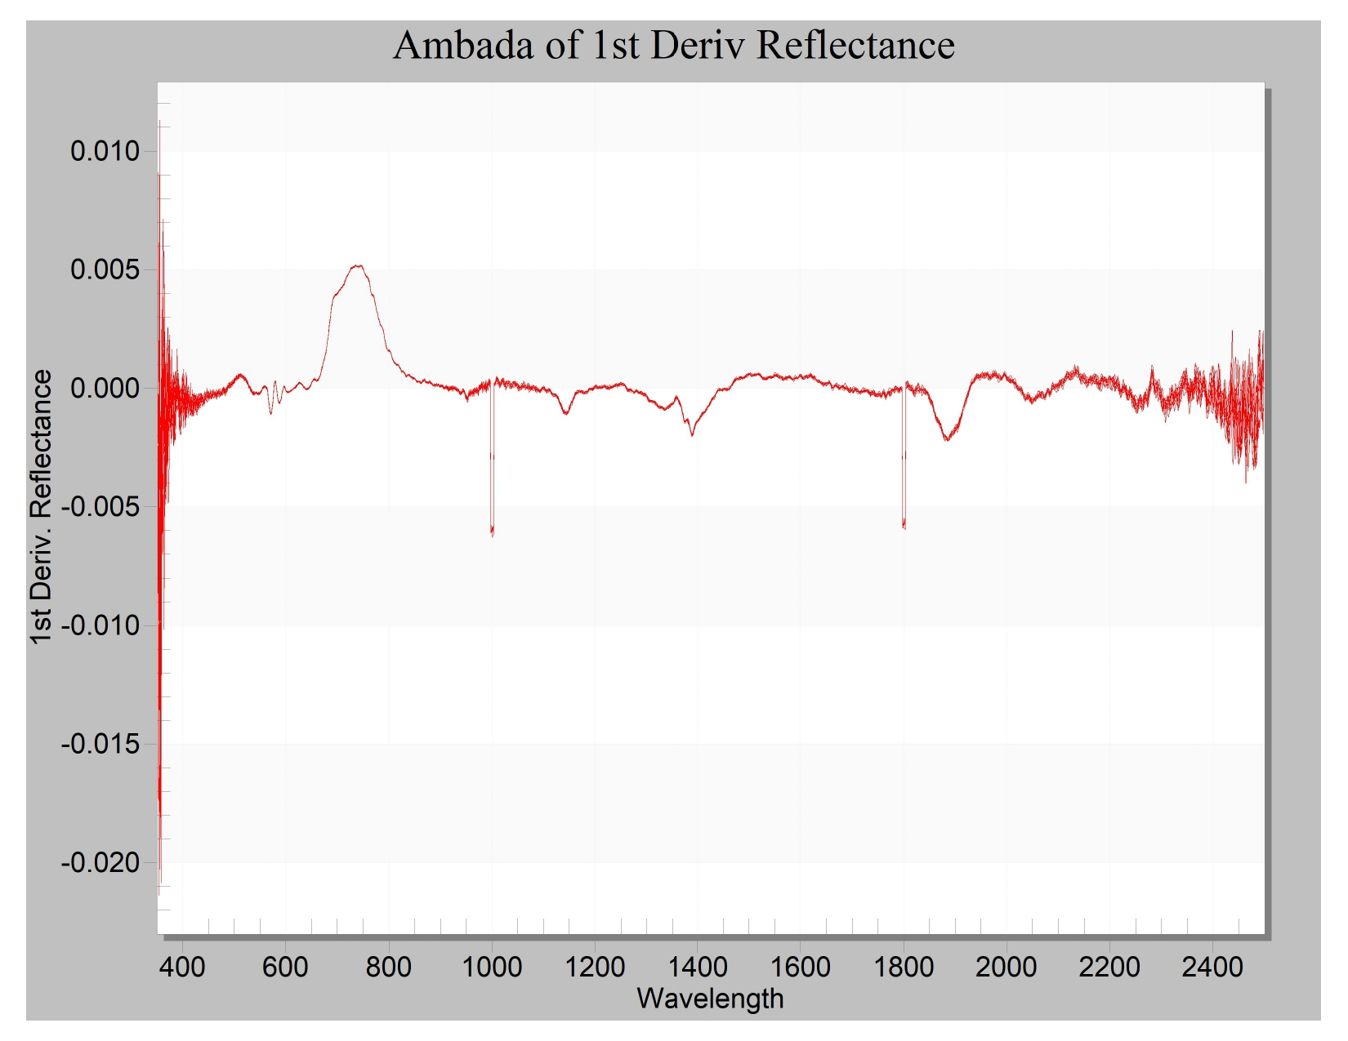
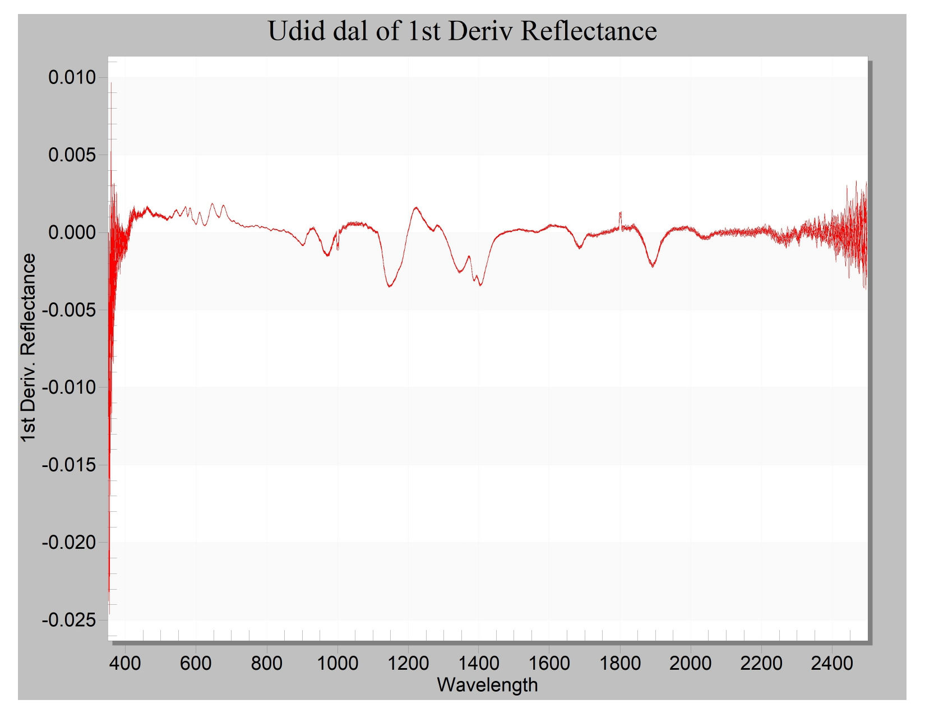
Feature extraction
Fig 6. Bel-Fruit
Fig 7. Jaggery
Fig 8. Ambada
Fig 9. Udid dal

Slide 13
Selected Features
Sr. no | Name of Data | Wavelength Range
1 | Bel - Fruit | 600nm – 800nm, 1000nm – 1200nm, 1350 – 1450nm & 1800nm – 1900nm
2 | Ambada | 650nm – 820nm, 1100nm – 1200nm 1350nm – 1450nm & 1850nm – 2000nm
3 | Udid Dal | 1300nm – 1450nm & 1800nm – 2000nm
4 | Jaggery | 500nm – 650nm, 850nm – 1000nm & 1100nm – 1300nm
Table 1. Selected Features of given data by their wavelength range

Slide 14
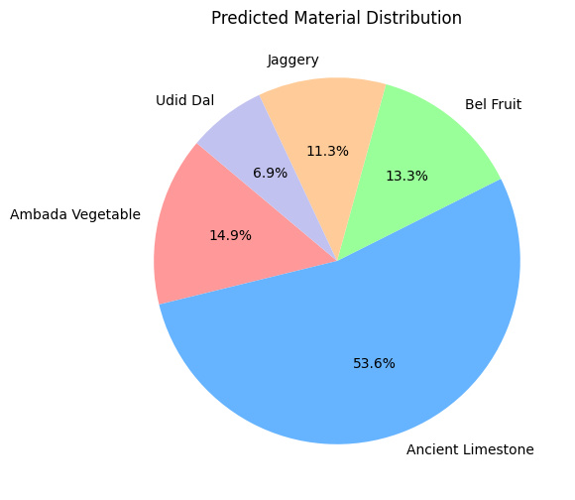
Result
SVM model accuracy: 93.60%
ML Model | Accuracy | Precision | Recall | F1-Score
Logistic Regression | 0.5142 | 0.38 | 0.51 | 0.36
SVM | 0.9360 | 0.94 | 0.89 | 0.91
Table 2. Comparison of ML model
Fig 10. Predicted Material Distribution

Slide 15
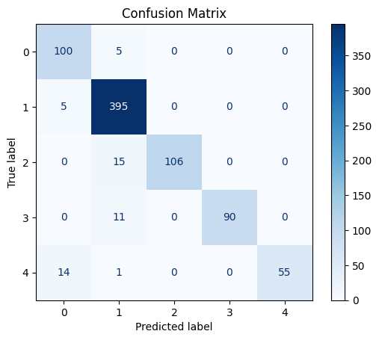
Confusion Matrix
Fig 11. Confusion Matrix

Slide 16
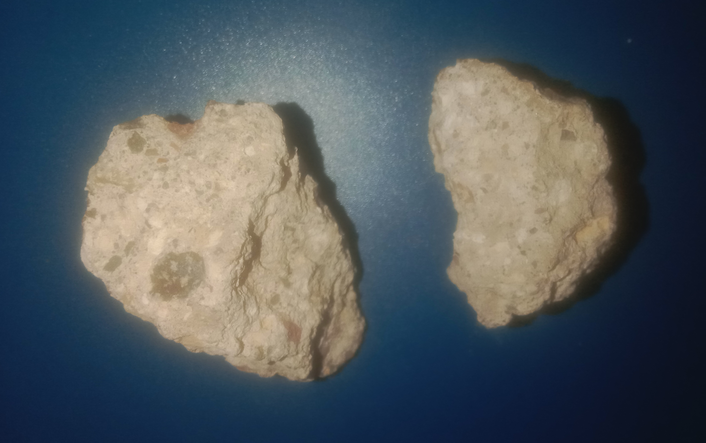
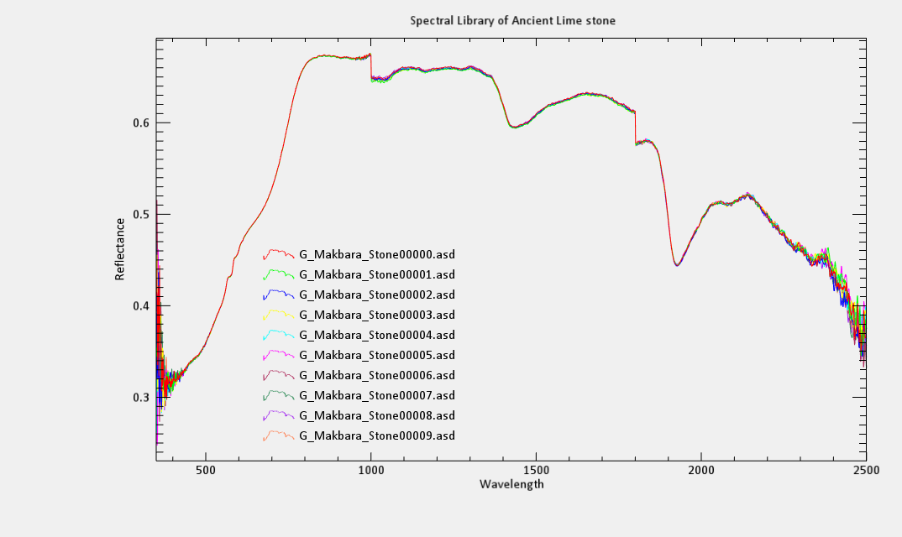
Development of Spectral Library
Fig 12. Ancient Limestone
Fig 13. Spectral signature of Limestone

Slide 17
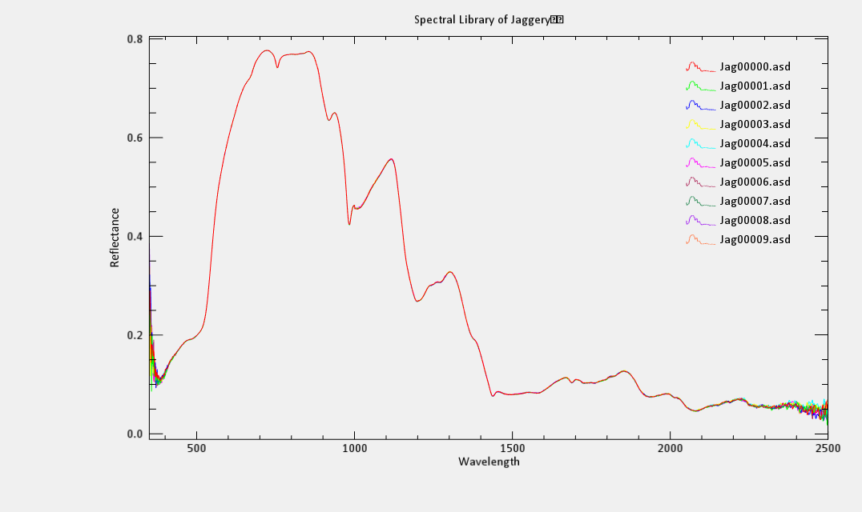
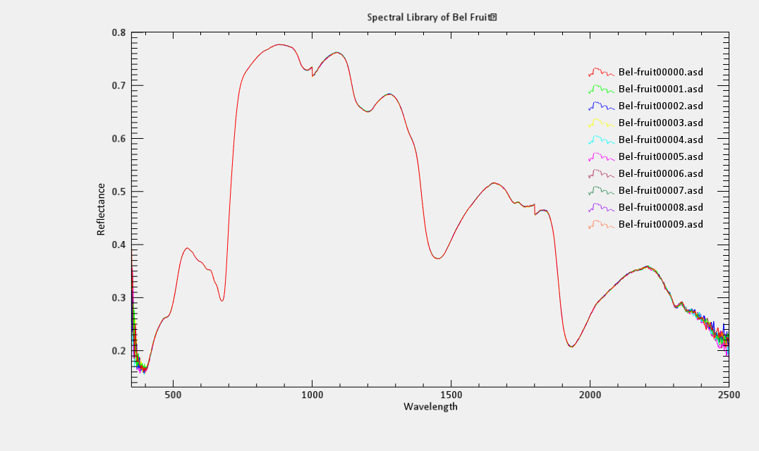
Conti..
Fig 14. Spectral Library of Jaggery
Fig 15. Spectral Library of Bel - Fruit

Slide 18
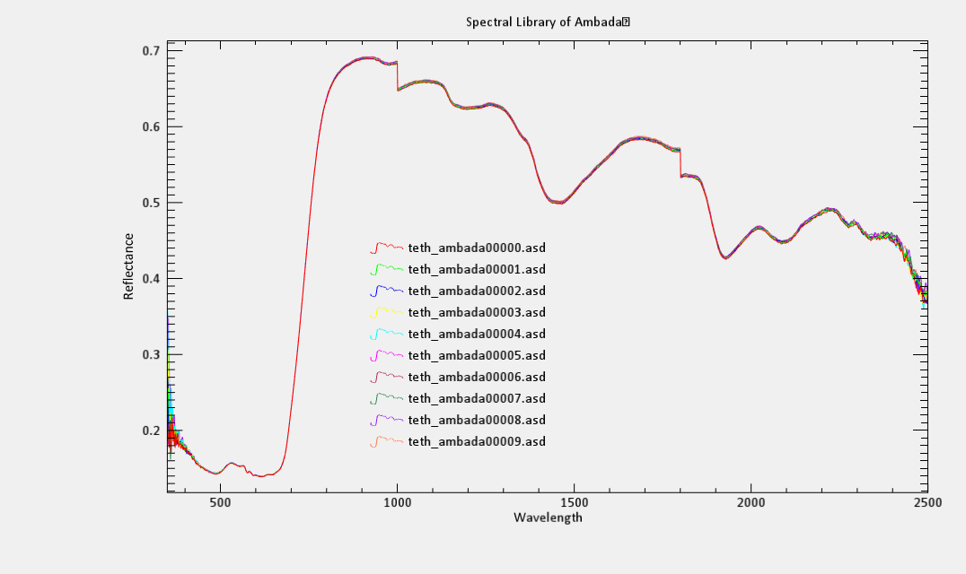
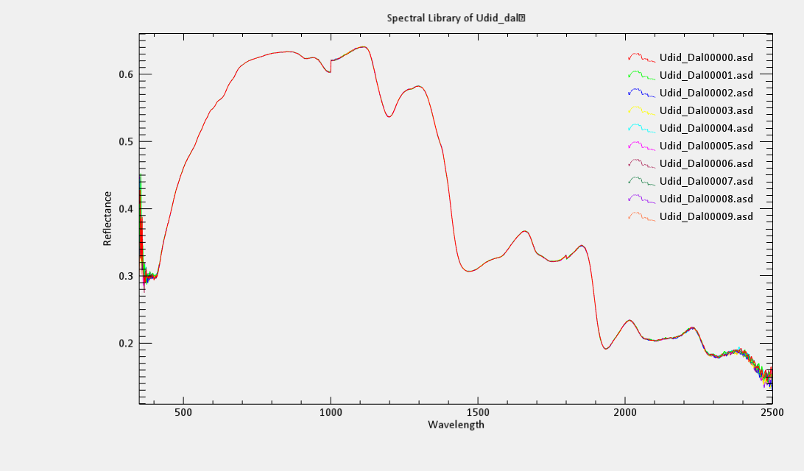
Conti..
Fig 16. Spectral Library of Amabada
Fig 17. Spectral Library of Udid Dal

Slide 19
Conclusion
This research provides a non-invasive way to identify materials used in ancient structures at Chh. Sambhajinagar BAMU University using hyperspectral non-imaging techniques.
By developing a spectral library
And applying machine learning, we improve material classification accuracy.
This study helps in preserving and restoring historical structures efficiently, offering a foundation for future advancements in heritage conservation.

Slide 20
Reference
[1] Dhangar, V. D., Dhole, P. V., Gawali, B. W., Shejul, S. D., & Kshirsagar, A. (2024). “Creating a spectral library of food samples through spectroscopic device integration with ENVI software.” Educational Administration: Theory and Practice, 30(5), 1542615432.
[2] Bhojaraja, B. E., Thanushree A. Hegde, Fathima Sunaina, and Ashray Shetty. "Compressive Strength Predictive Analysis using Spectroradiometer." In IOP Conference Series: Earth and Environmental Science, vol. 1387, no. 1, p. 012005. IOP Publishing, 2024.
[3] Janse, Pooja Vinod, Jaypalsing N. Kayte, Rashmi V. Agrawal, and Ratnadeep R. Deshmukh. "Standard spectral reflectance measurements for ASD FieldSpec Spectroradiometer." In 2018 Fifth International Conference on Parallel, Distributed and Grid Computing (PDGC), pp. 729733. IEEE, 2018.
[4] Dhangar, Vijay. "Exploring the Spectral Database of Food Samples Using ASD Field Spec 4 Spectroradiometer." Available at SSRN 4900729 (2024).
[5] Maid, Monali K., and Ratnadeep R. Deshmukh. "Statistical analysis of WLR (wheat leaf rust) disease using ASD FieldSpec4 spectroradiometer." In 2018 3rd IEEE International Conference on Recent Trends in Electronics, Information & Communication Technology (RTEICT), pp. 13981402. IEEE, 2018.
[6] Fang, Tianke, Zhenxing Hui, William P. Rey, Aihua Yang, Bin Liu, and Yuanrong He. "Machine Learning-Based Crack Detection Methods in Ancient Buildings." In Proceedings of the 2024 Guangdong-Hong Kong-Macao Greater Bay Area International Conference on Digital Economy and Artificial Intelligence, pp. 885-890. 2024.
[7] Jiang, Xuejie, Siti Norlizaiha Harun, and Linyu Liu. "Explainable artificial intelligence for ancient architecture and lacquer art." Buildings 13, no. 5 (2023): 1213.
[8] Fais, Silvana, Giuseppe Casula, Francesco Cuccuru, Paola Ligas, and Maria Giovanna Bianchi. "An innovative methodology for the non-destructive diagnosis of architectural elements of ancient historical buildings." Scientific reports 8, no. 1 (2018): 4334.

Slide 21
Thank You

